Slide 1
Image Feature Correspondences for Camera Calibration
Software Requirements Specification
Kiran Singh
CAS 741
2025-02-03

Slide 2
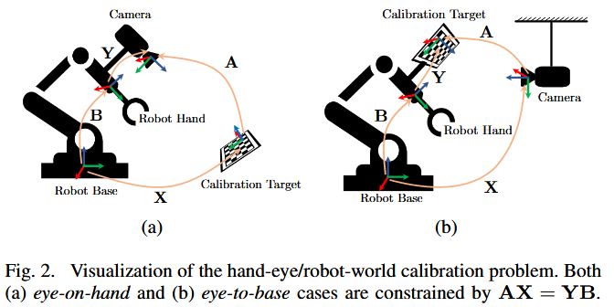
Overview
Cameras need to be calibrated to provide useful data
Broken into two portions –
Intrinsics (Image plane to camera frame)
Extrinsics (Camera frame to world frame)
Current methods face trade-offs, including:
local solver tools
pre-known calibration targets/features of known scale within the environment
Overlap in camera fields-of-view (FOV)
Broader goal to develop calibration algorithm that overcomes these limitations
Envisioned to be completed in two steps:
Identify features from ‘key points’ in imagery data for use as calibration targets
Compute robotic posed transforms in HERW formulation via a global optimization algorithm
[1] Y. Wang et al.
Scope for CAS 741

Slide 3
Goals Statements
Provided the configuration data of each camera, inclusive of the intrinsic parameters and imagery streams, and the ground-truth robot pose, the goals of this software are:
Goal ID | Description
GS01 | Define the criteria used to identify features between separate image frames.
GS02 | Define a collection of features from each image frame.
GS03 | Compare the identified features from GS02 between each image frame.
GS04 | Compute the number of matches in each image frame per the criteria in GS03
GS05 | Generate a report of the matched features between each image.

Slide 4
Assumptions
Goal ID | Description
A01 | Feature matching can be performed on any positive, real number of cameras.
A02 | All supplied imagery is produced by a pinhole model, affine camera. [TM01]
A03 | Intrinsic calibration parameters are unique for each camera. [TM01]
A04 | The transform between the global coordinate frame and the robot base frame is assumed to be known.

Slide 5
Perceived Workflow – Separate to SRS
Image Feature Correspondence Software
Camera Parameters / Imagery Stream
Feature Identification
Feature Comparison
Keypoint Matches/ Graph Generation
Graph of
Flagged Transforms
Feature Detection Algorithm
w/ Threshold Criteria
Feature Comparison Algorithm
w/ Threshold Criteria

Slide 6
Inputs and Outputs
Inputs
In1) Camera configuration parameters
In1A) Quantity of cameras, i (i >0)
In1B) Camera Intrinsic Parameters (TM01)
In2) Robot Pose Ground Truth (P_{i})
Global Position of end-effector
Translation (Cartesian Coordinates)
Rotation (Roll, Pitch, Yaw – const. from –π < θ ≤ π)
In3) Imagery stream data (IM01)
For pose P_{i} and camera C_{j}
Imagery resolution, m _{x} n, (m, n > 0)
Imagery vector (RBG)
In4A) Feature Detector Algorithm*
In4B) User-defined threshold
In5A) Feature Comparison Algorithm**
In5B) User-defined threshold
Outputs
For each camera, C
Out1) For each image, i:
A graph of identified features and its constitutive points
Out2) A graph of each matched feature with the corresponding camera, image frame, and matched features
Out3) A confidence metric for each matched feature
Out4) A list of transforms to be calculated between each matched feature
Notes:
How do we encapsulate the Feature Detector and Feature Comparison Algorithms

Slide 7
General Definitions
GD01: Feature
A flag that classifies a collection of key points in image I to be contain similar properties as outlined in the Feature Detection Algorithm
GD02: Correspondence
A flag between two identified features from separate images which exceeds the comparison threshold as defined in the Feature Comparison Algorithm

Slide 8
Theoretical Models
Need to define how the theoretical/instance models such that we do not over specify:
What type of feature detection/matching algorithm are employed
What are the selection criteria that define a correspondence, for similar reasons to (1)
ID | Description
TM01 | Intrinsic Camera Parameter, K
TM02 | 2D Gaussian Kernel
TM03 | Integral Image Computation
TM04 | Hessian-Based Interest Points [LC01]
TM05 | FAST-9

Slide 9
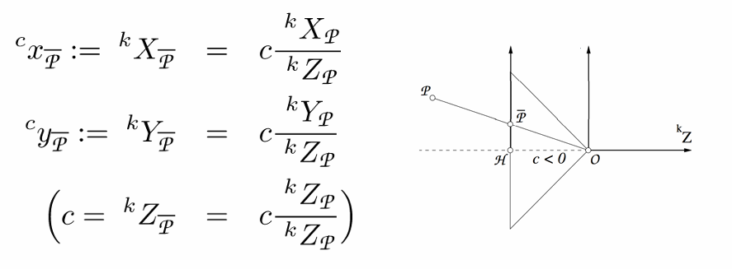
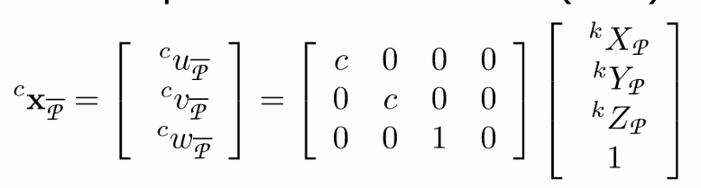

TM01 – Intrinsic Camera Parameters
For a known point, P, we obtain its coordinates for the projection point on the 2D image plane
Assumptions
Pinhole camera model – A02
Intrinsic Calibration Parameters (K) may differ for each camera - A03
[1] C. Stachniss.

Slide 10

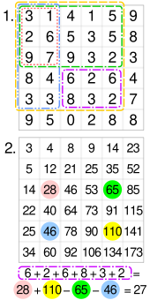
TM02 – Integral Image
For point X in each image, a ‘summed image’ contains the summation of the image intensity for all pixels formed by the origin and point X.
[3] D. Tyagi.
[4] Wikipedia, “Summed-area table”.

Slide 11
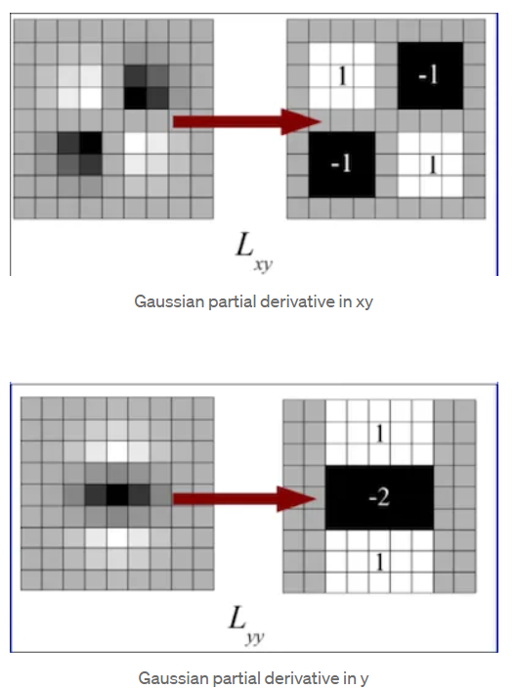
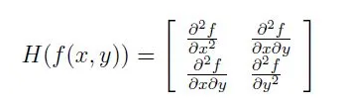
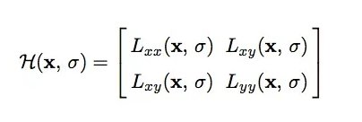
TM03 – Hessian-based Interest Points
Some variants for feature detection used Hessian-based interest points
For a given pixel x = (x,y)
Adapt to a defined scale, σ, with a Gaussian Kernel *
[3] D. Tyagi.
‌‌

Slide 12
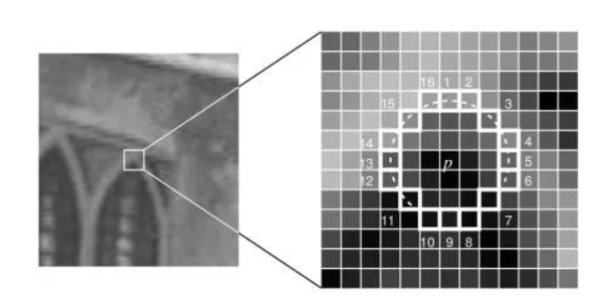
TM04 – FAST-9
For the intensity of pixel p, (I_{p})…
Compare pixel intensity within adjacent norm ≤ 3
Check…
For i in n contiguous pixels
intensity threshold, t
Threshold count, q
Count if (I_{i} > | I_{p} ± t |)
[5] D. Sharma.

Slide 13
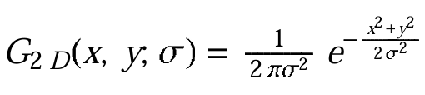

TM05 – 2D Gaussian Kernel
Used in numerous image processing techniques as a smoothing filter
Applications include:
Scaling pyramids
BRIEF
Hessian activities (TM04)
Inputs
Image, I(x,y)
Standard deviation, σ
Outputs
Transformed image, I(x, y, σ)
[6] M. K. Chung.

Slide 14
Instance Models
IM01: Feature Detector
Upload RGB camera data.
Convert RGB data to grayscale.
Define scale-pyramid depth and edge variance (σ) tolerance
For each image frame, i:
5. For each camera, j:
6. Define scale-invariant image models.
7. Perform feature detection.
Adjust features for rotation.
Define centroid.
9. Define keypoints from features.
10. Compile vector of collected keypoints for camera image, C[i, j].
11. End inner loop.
End outer loop.
Return ixj structure of features.

Slide 15

Instance Models
IM01: Feature Comparison
1. For each pose, i
2. For each camera, j
Compare vector C[i, j] to all other vectors in
5. If ≥1 keypoint match with image C[a, b]
6. Align images C[a, b] with C[I, j] with homography *
Repeat keypoint comparison *
Create vector of keypoint correspondences, w/ confidence metrics
Report homography transforms.
End inner loop.
11. End outer loop.
Return ixj structure of matches + transforms.

Slide 16
References
[1] Y. Wang, W. Jiang, K. Huang, S. Schwertfeger, and L. Kneip, “Accurate Calibration of Multi-Perspective Cameras from a Generalization of the Hand-Eye Constraint,” in 2022 International Conference on Robotics and Automation (ICRA), Philadelphia, PA, USA: IEEE, May 2022, pp. 1244–1250. doi: 10.1109/ICRA46639.2022.9811577.
[2] C. Stachniss. (2021). Camera Parameters: Extrinsics and Intrinsics [Online]. Available: https://www.ipb.uni-bonn.de/html/teaching/photo12-2021/2021-pho1-20-camera-params.pptx.pdf.
[3] D. Tyagi, “Introduction to SURF (Speeded-Up Robust Features),” Medium, Apr. 07, 2020. [Online]. Available: https://medium.com/@deepanshut041/introduction-to-surf-speeded-up-robust-features-c7396d6e7c4e
[4] Wikipedia Contributors, “Summed-area table,” Wikipedia, Sep. 21, 2019. [Online]. Available: https://en.wikipedia.org/wiki/Summed-area_table.
[5] D. Sharma, "Introduction to ORB (Oriented FAST and Rotated BRIEF)," Medium, Feb. 6, 2019. [Online]. Available: https://medium.com/@deepanshut041/introduction-to-orb-oriented-fast-and-rotated-brief-4220e8ec40cf. [Accessed: Feb. 2, 2025].‌‌
[6] M. K. Chung, “The Gaussian Kernel" University of Wisconsin–Madison, [Online]. Available: https://pages.stat.wisc.edu/~mchung/teaching/MIA/reading/diffusion.gaussian.kernel.pdf. [Accessed: Feb. 2, 2025].

Slide 17
Functional / Non-Functional Requirements
Future Work
To be discussed following revisions to TM, GD, DD, and IMs

